Slide 1




View In Charts q2 2024
Rathbones Group Plc

Slide 2

Order of service
What has happened in the past year? | 3
The outlook for inflation | 7
The outlook for interest rates | 12
The outlook for economic growth | 16
Investment strategy for 2024 | 21

Slide 3
What happened over the past 12 months?
Most developed market equities rose (FTSE indices, GBP total returns, %)
Sources: LSEG, Rathbones
Investments can go down as well as up and you could get back less than you invested. Past performance is not a reliable indicator of future results.

Slide 4
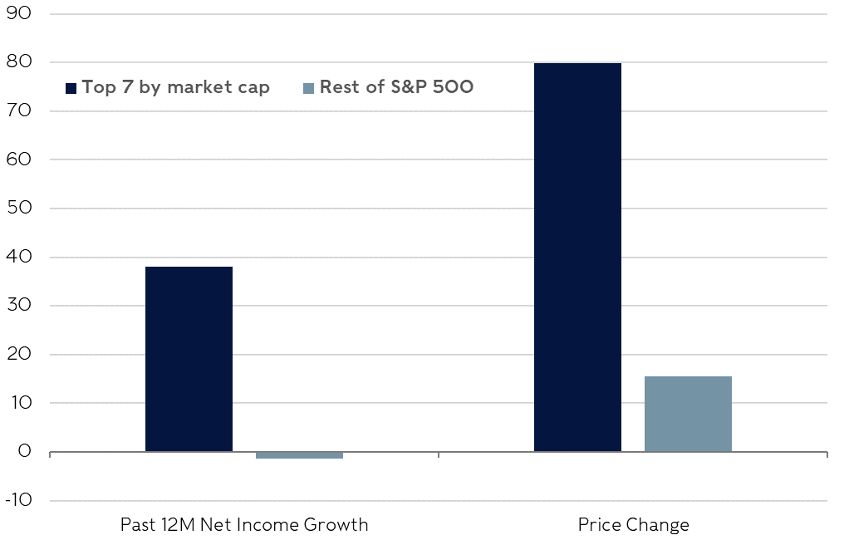
sentiment drove returns in the US for all but the largest companies – profits were essentially flat
Changes since March 2023 (%)
Sources: LSEG, Rathbones
Investments can go down as well as up and you could get back less than you invested. Past performance is not a reliable indicator of future results.

Slide 5
The ‘Magnificent Seven’ dominated returns for most of 2023, but the rally has broadened out since early November
Total returns (%)
Sources: LSEG, Rathbones
Investments can go down as well as up and you could get back less than you invested. Past performance is not a reliable indicator of future results.

Slide 6

Key takeaways
Developed market equities have surged since early November lows
Chinese assets have struggled, despite picking up a bit in the past couple of months
Outside of the largest stocks, profit growth in the US has stalled
Gains were therefore driven by confidence in future profits
Equity returns have broadened out in recent months, after being limited to a few mega-cap stocks prior to November 2023

Slide 7
Headline inflation has fallen as quickly as it climbed; there is a little further to go
Advanced economy CPI inflation (trimmed means, 38 OECD nations*)
Sources: LSEG, Rathbones; *trimmed means remove a small percentage of the outlying largest and smallest values; the OECD is the Organisation for Economic Cooperation and Development

Slide 8
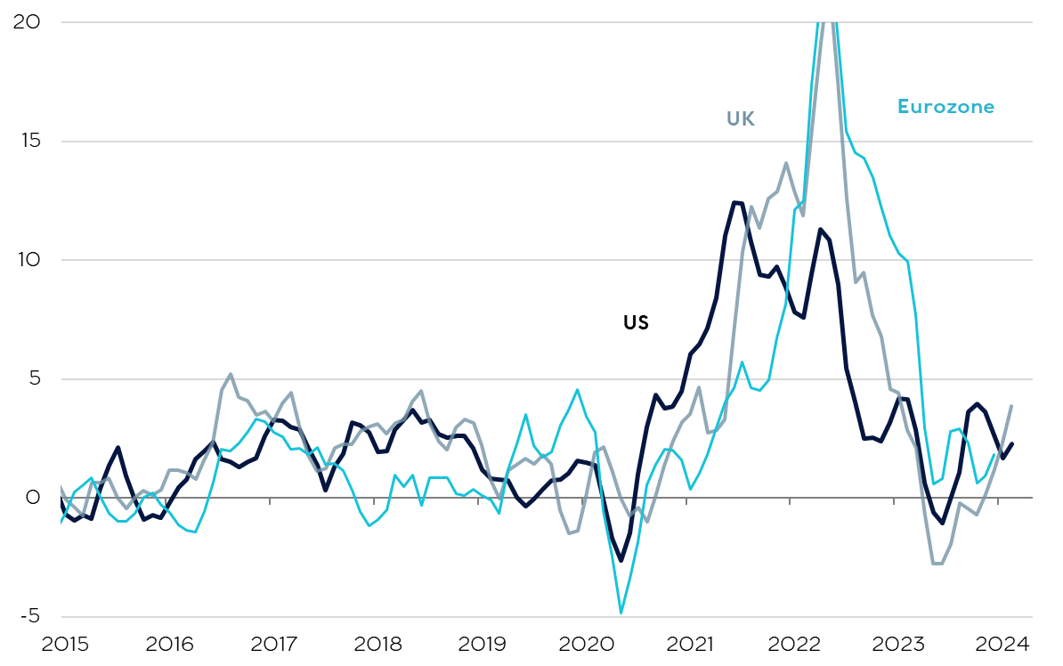
Attacks on vessels in the red sea have raised shipping costs, but there have been limited signs of it affecting goods prices
3-month annualised inflation for goods producers (%)
Sources: LSEG, Rathbones; highest values intentionally cut off to remove outlying data and show the recent trend more clearly.

Slide 9
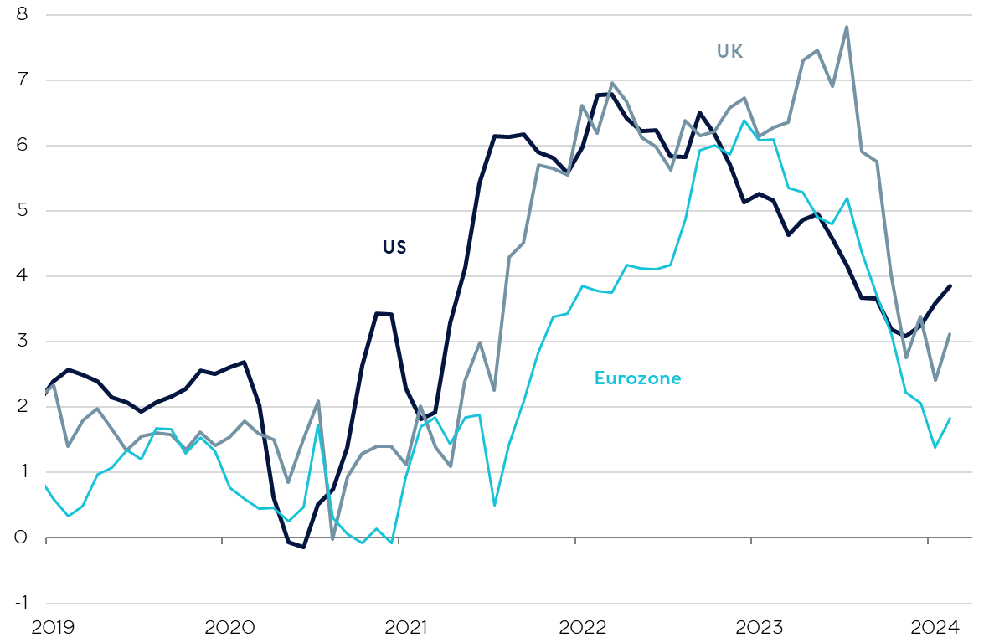
Strong disinflationary momentum continues in Europe, but upside risks emerging in the US
6-month annualised core CPI* inflation rates (%)
Sources: LSEG, Rathbones; *consumer price index, core CPI removes volatile food and energy components

Slide 10
Salaries offered to new employees suggest inflation pressure will continue to fade, but uncertainty remains
US wage growth (% year on year)
Sources: LSEG, Indeed.com, Rathbones

Slide 11
Key takeaways
Investors are right to cheer a huge reduction in inflation uncertainty so far
The disinflationary momentum has been profound, especially in Europe
Wage growth has slowed more gradually, but there has still been solid progress
The latest data suggests the risks of inflation proving persistent are greater in the US than in the UK and Europe

Slide 12
Markets are expecting similarly mild interest rate cuts in the us and uk, despite differences in inflationary pressures
Market-implied interest rate expectations (%)
Sources: LSEG, Rathbones
Investments can go down as well as up and you could get back less than you invested. Past performance is not a reliable indicator of future results.

Slide 13
Markets are only pricing in modest interest rate cuts by historical comparison
Fed Funds Rate after last rate hike of the cycle (%)
UK Bank Rate after last rate hike of the cycle (%)
Sources: LSEG, Bloomberg, Rathbones
Investments can go down as well as up and you could get back less than you invested. Past performance is not a reliable indicator of future results.

Slide 14
Bond yields are still high by recent standards
10-year government bond yields (%)
Sources: LSEG, Rathbones
Investments can go down as well as up and you could get back less than you invested. Past performance is not a reliable indicator of future results.

Slide 15
Key takeaways
Interest rates will probably fall in 2024, but there’s lots of uncertainty about how far
The market expects 3 quarter-point rate cuts in 2024 in the US and UK
If economies take a turn for the worse, rates will probably fall much further
If conditions don’t deteriorate, rates could still fall a little
Government bonds should provide us with protection if there is a recession, and meanwhile pay high yields by recent standards
The risk of rates falling by more than markets expect seems greater in the UK than the US
Investments can go down as well as up and you could get back less than you invested. Past performance is not a reliable indicator of future results.

Slide 16
Broadly speaking, leading economic data haS been improving recently
Global GDP and Rathbones Leading Economic Indicator
Sources: LSEG, Rathbones

Slide 17
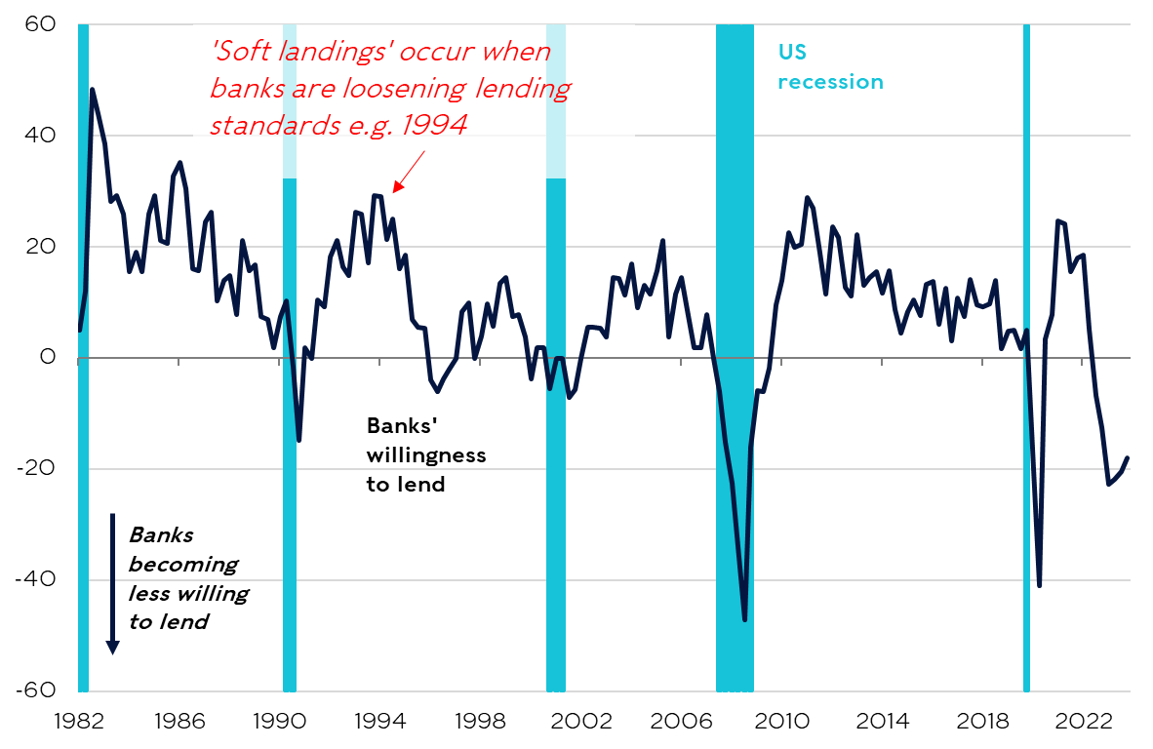
Banks are still tightening lending standards, but to a lesser extent than in recent quarters
US Senior Loan Officer Survey and recessions
Sources: LSEG, Rathbones

Slide 18
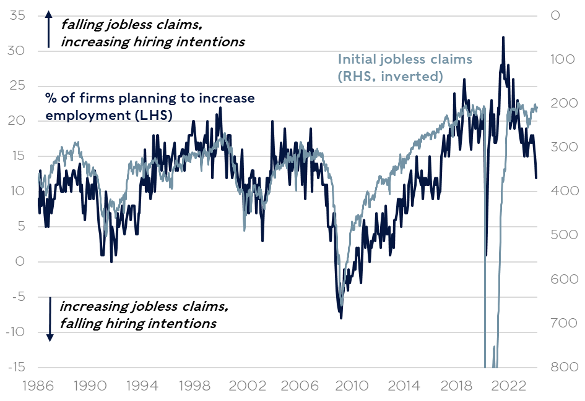
Economic risks haven’t vanished; IF hiring intentions keep falling, layoffs could rise
US initial jobless claims and firm hiring plans
Sources: LSEG, Rathbones

Slide 19
Some indicators of activity in China have picked up, but the deep property downturn will have long-lasting effects
Growth in China’s exports and imports (% y/y, USD)
China housing starts and sales (mns of square metres)
Sources: LSEG, Rathbones

Slide 20
Key takeaways
Many leading indicators have improved recently, and the risk of recession appears to have diminished
But it has not disappeared either; the effects of previous tightening in monetary policy and banks’ lending standards may still be feeding through

Slide 21
As 2023 reminded investors, switching to cash when interest rates peak usually doesn’t pay off
Performance of US equities vs cash portfolios (% median performance following peaks in interest rates since 1960)
Sources: LSEG, Rathbones
Investments can go down as well as up and you could get back less than you invested. Past performance is not a reliable indicator of future results.

Slide 22
Historically, bonds begin to outperform in the months before rate cuts happen
Median performance of gilts around the start of easing cycles
Sources: LSEG, Rathbones; performance of 10-year and 2-year UK government bonds
Investments can go down as well as up and you could get back less than you invested. Past performance is not a reliable indicator of future results.

Slide 23
Firms which have strong balance sheets, higher interest coverage and more efficient investments have outperformed
Sector-neutral ‘quality factor’ outperformance (highest ‘quality’ vs lowest ‘quality’)
Sources: Piper Sandler, Rathbones
Investments can go down as well as up and you could get back less than you invested. Past performance is not a reliable indicator of future results.

Slide 24
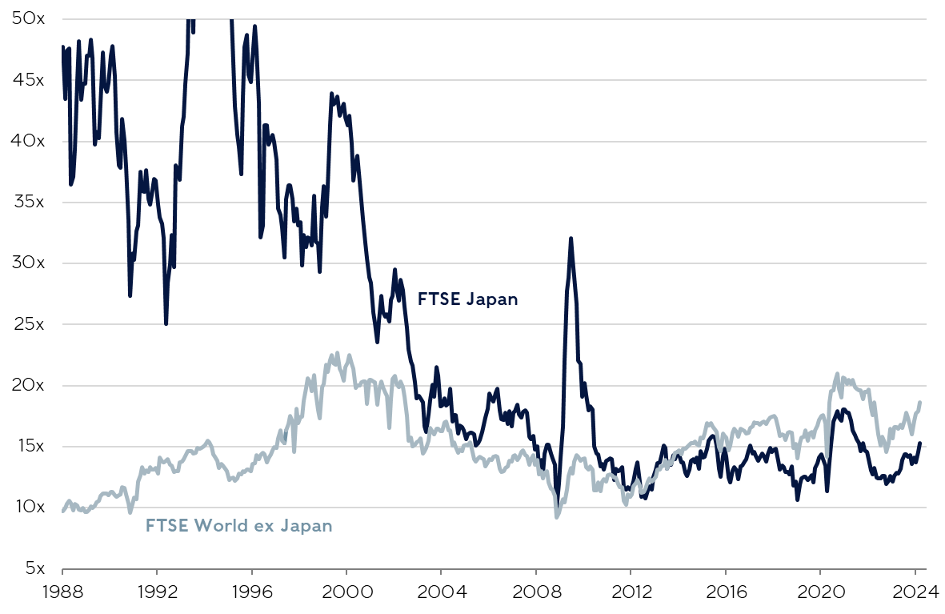
Japan’s NIKKEI INDEX HAS SURPASSED ITS 1989 PEAK; UNLIKE BACK THEN, VALUATIONS ARE MORE ATTRACTIVE RELATIVE TO ELSEWHERE
12M forward price/earnings ratios*
Sources: LSEG, Rathbones; *prices relative to forecasted earnings over the next 12 months
Investments can go down as well as up and you could get back less than you invested. Past performance is not a reliable indicator of future results.

Slide 25


Companies aligned to major structural themes may do well
Investments can go down as well as up and you could get back less than you invested. Past performance is not a reliable indicator of future results.

Slide 26
Smaller stocks appear attractively valued, especially compared to US large caps
Difference in 12M forward price/earnings ratios* to S&P 500
Sources: LSEG, Rathbones;*prices relative to forecasted earnings over the next 12 months
Investments can go down as well as up and you could get back less than you invested. Past performance is not a reliable indicator of future results.

Slide 27
Key takeaways
The big lesson from 2023: markets have been volatile but if you were able to accept risk, it made sense to stay invested
Look for structural drivers, such as those found in Japan or from the major themes of a changing world
Look for areas that appear undervalued, such as smaller stocks in the US and Europe
With many market segments offering very attractively priced opportunities, there’s much to look forward to, even if there are a few bumps in the road ahead
Investments can go down as well as up and you could get back less than you invested. Past performance is not a reliable indicator of future results.

Slide 28
Additional INFORMATION
  Information valid as of 20.03.2024 unless otherwise stated.
  Tax regimes, bases and reliefs may change in the future.
  Rathbones Group Plc is independently owned, is the sole shareholder in each of its subsidiary businesses and is listed on the London Stock Exchange.
  Issued and approved by Rathbones Investment Management Limited, which is authorised by the Prudential Regulation Authority and regulated by the Financial Conduct Authority and the Prudential Regulation Authority. Registered office: Port of Liverpool Building, Pier Head, Liverpool L3 1NW, Registered in England No. 01448919.
  Rathbones is the trading name of Rathbones Investment Management Limited.
  Rathbones Asset Management Limited is authorised and regulated by the Financial Conduct Authority. Registered office: 8 Finsbury Circus, London EC2M 7AZ, Registered in England No. 02376568.
  Provision of trust, tax and company administration services are provided by Rathbones Trust Company Limited (RTC). Provision of legal services is provided by Rathbones Legal Services Limited (RLS), a wholly owned subsidiary of RTC. RLS is authorised and regulated by the Solicitors Regulation Authority. It should be noted that any services provided by RTC are not regulated by either the Financial Conduct Authority nor the Prudential Regulation Authority. Rathbones Trust Company Limited and Rathbones Legal Services Limited are registered in England under company numbers 01688454 and 10514352 respectively.
  Rathbone Financial Planning is part of Rathbones Investment Management Limited. It should be noted that not all the services provided by Rathbone Financial Planning are regulated by either the Financial Conduct Authority or the Prudential Regulation Authority.
Rathbones Investment Management International is the Registered Business Name of Rathbones Investment Management International Limited, which is regulated by the Jersey Financial Services Commission. Registered office: 26 Esplanade, St. Helier, Jersey JE1 2RB. Company Registration No. 50503.
Rathbones Investment Management International Limited is not authorised or regulated by the Prudential Regulation Authority or the Financial Conduct Authority in the UK. Rathbones Investment Management International Limited is not subject to the provisions of the UK Financial Services and Markets Act 2000 and the Financial Services Act 2012; and, investors entering into investment agreements with Rathbones Investment Management International Limited will not have the protections afforded by those Acts or the rules and regulations made under them, including the UK Financial Services Compensation Scheme.
This document is not intended as an offer or solicitation for the purchase or sale of any financial instrument by Rathbones Investment Management International Limited. The information and opinions expressed herein are considered valid at publication, but are subject to change without notice and their accuracy and completeness cannot be guaranteed. No part of this document may be reproduced in any manner without prior permission.
Greenbank and Greenbank Investments are trading names of Rathbones Investment Management Limited, which is authorised by the Prudential Regulation Authority and regulated by the Financial Conduct Authority and the Prudential Regulation Authority.
No part of this document may be reproduced in any manner without prior permission.
© 2024 Rathbones Group Plc. All rights reserved.

