Slide 1




View In Charts q2 2024
Rathbones Group Plc

Slide 2

Order of service
What has happened in the past year? | 3
The outlook for inflation | 7
The outlook for interest rates | 12
The outlook for economic growth | 16
Investment strategy for 2024 | 21

Slide 3
What happened over the past 12 months?
Most developed market equities rose (FTSE indices, GBP total returns, %)
Sources: LSEG, Rathbones
Investments can go down as well as up and you could get back less than you invested. Past performance is not a reliable indicator of future results.
Notes:
- Developed market equities have continued to do well this year, particularly the US equity benchmark – the dark blue line on this chart – although more and more global companies are participating in these rising markets.
- With signs that a near 18-month long stagnation in Eurozone economic activity is ending, its equity markets have been leading the way over the last month – we upgraded the region at the end of January.
- Emerging market equities have underperformed significantly over the last 12 months, led lower by China (light grey line at the bottom of the chart), a market we’ve been very bearish on for some time now, even when pretty much everyone was getting very bullish 12 months or so ago.
- We remain sceptical about China’s ability to outperform sustainably over the next few years. Several factors continue to bear down on China’s trend growth rate, not least what will likely be a multi-year fallout from the bust of its overinflated property sector. But the Chinese authorities appear have done enough to stabilise the economy, with economic data improving over the last couple of months. This certainly helps the global economic outlook this year and should help broader investor sentiment.

Slide 4
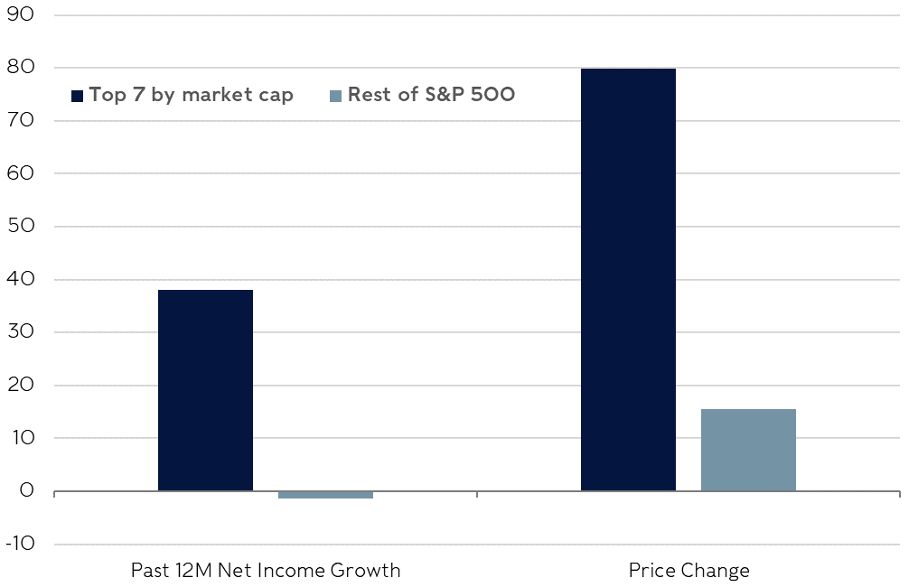
sentiment drove returns in the US for all but the largest companies – profits were essentially flat
Changes since March 2023 (%)
Sources: LSEG, Rathbones
Investments can go down as well as up and you could get back less than you invested. Past performance is not a reliable indicator of future results.
Notes:
While stock prices have been rising and broadening out, substantial profit growth is still relatively rare and most companies have seen analysts around the industry revise down forecasts for 2024, for all but the highest quality and sector-leading companies: finding these remains a core focus of our equity selection process.
As we’ll see shortly in the next section, while we believe that the outlook for the global economy and corporate profits has brightened significantly and that the risks have receded, they haven’t vanished entirely and we are conscious that some stock prices have moved ahead of where the probability-weighted outlook for profits suggests they should be. With investors, especially in the US, demanding much lower compensation for equity risk than they have done for most of the last 15 years (low ERP), we must question if investors are being compensated for the lingering uncertainties, even if those uncertainties are much reduced.
We have become much more confident that investors can achieve good medium-term returns, but there may be another bump or two in 2024’s road ahead.

Slide 5
The ‘Magnificent Seven’ dominated returns for most of 2023, but the rally has broadened out since early November
Total returns (%)
Sources: LSEG, Rathbones
Investments can go down as well as up and you could get back less than you invested. Past performance is not a reliable indicator of future results.
Notes:
More and more companies are participating in rising markets. The dark blue bars show performance of the so-called magnificent 7 mega-sized tech stocks in the first 10 months of last year compared to other large, medium-sized and smaller companies (as you progress left to right along the horizontal axis). The blue-grey bars show their performance more recently – much more comparable.
It’s worth remembering that the very largest stocks in the index at any point in time, as indominable as they may seem contemporaneously, usually underperform over 5 years or more. This is a strong case against passive investing, which allocates more to the giants than anyone else.

Slide 6

Key takeaways
Developed market equities have surged since early November lows
Chinese assets have struggled, despite picking up a bit in the past couple of months
Outside of the largest stocks, profit growth in the US has stalled
Gains were therefore driven by confidence in future profits
Equity returns have broadened out in recent months, after being limited to a few mega-cap stocks prior to November 2023

Slide 7
Headline inflation has fallen as quickly as it climbed; there is a little further to go
Advanced economy CPI inflation (trimmed means, 38 OECD nations*)
Sources: LSEG, Rathbones; *trimmed means remove a small percentage of the outlying largest and smallest values; the OECD is the Organisation for Economic Cooperation and Development
Notes:
We track inflation across 38 advanced economies. As this graph shows it took 15 months for the average rate of inflation to peak once it broke beyond the historic mean in 2021, and it’s taken more or less the same number of months to fall back below that threshold.
Core inflation, which excludes energy and food price inflation, is on track to do the same, and indeed it has fallen at a sharper pace than it rose. But it still has further to go to reach that historic average. Remember, it’s core inflation that central bankers tend to focus on when setting interest rates because they can’t do much about the price of oil or wheat.
There is good evidence that there is more disinflationary pressure in the pipeline, not least because there is no longer excess money creation, but the final mile may be tough in the US.

Slide 8
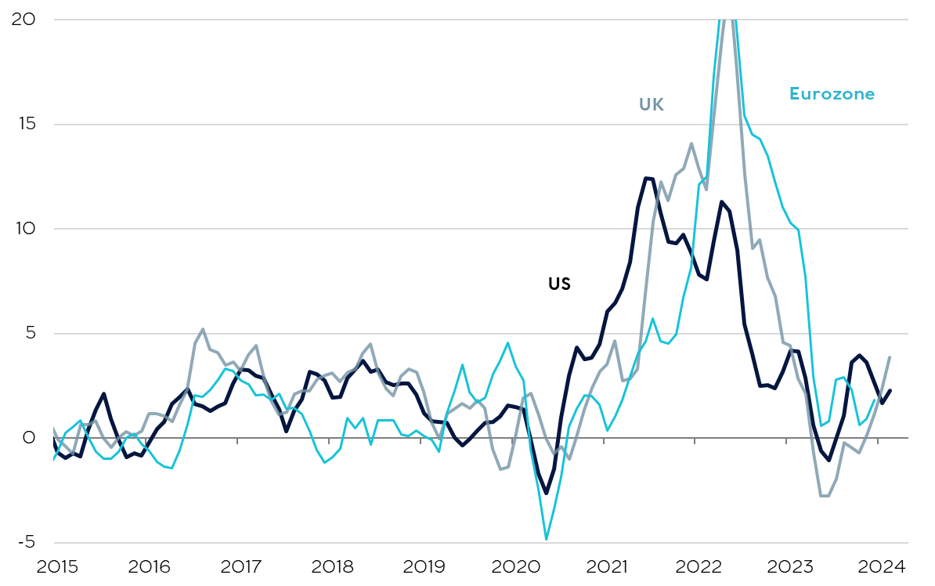
Attacks on vessels in the red sea have raised shipping costs, but there have been limited signs of it affecting goods prices
3-month annualised inflation for goods producers (%)
Sources: LSEG, Rathbones; highest values intentionally cut off to remove outlying data and show the recent trend more clearly.
Notes:
Earlier in the year, some investors were concerned about goods prices spiking as a result of shipping disruptions in the important Red Sea route.
Sea container freight costs are still elevated, but they have fallen by around 15% over the last month.
They haven’t spiked across all routes all over the world like in 2021. Moreover, unlike last time, inventories aren't unusually low, and shipping costs aren't joining a perfect storm of supply and demand shocks to unleash a huge wave of inflation more broadly.
Core goods price inflation is back around its deflationary norm in many countries.

Slide 9
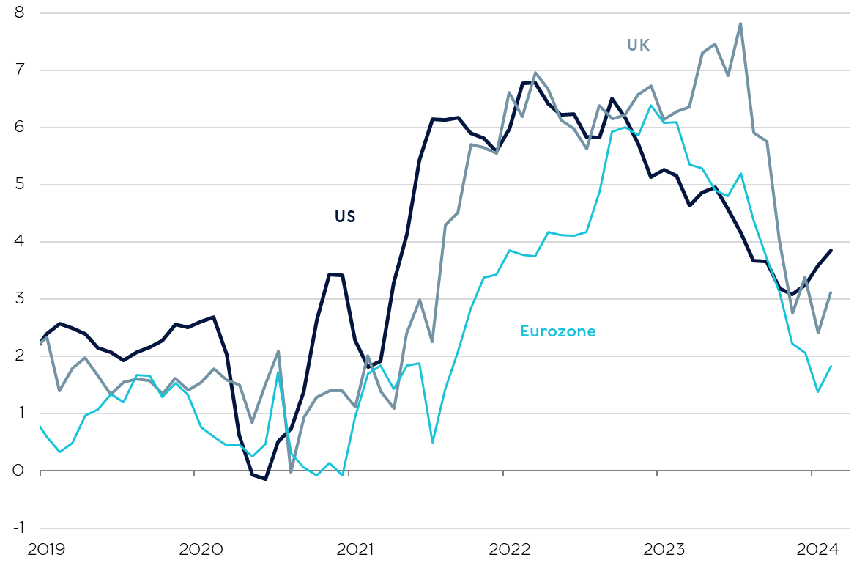
Strong disinflationary momentum continues in Europe, but upside risks emerging in the US
6-month annualised core CPI* inflation rates (%)
Sources: LSEG, Rathbones; *consumer price index, core CPI removes volatile food and energy components
Notes:
In the UK and the eurozone we’re confident about the direction of travel.
UK Energy price deflation will continue before fading towards the end of the year. Consumer food price inflation, which was adding c.1.5ppt to UK headline inflation in January, is set to drop to zero (it follows producer food price inflation closely, with a 6-month delay), bringing overall inflation below 2% in the spring.
Other goods prices are deflating now, and while service sector inflation is elevated, monthly price rises have been diminishing and there are good indications that’s likely to continue, led by softer wage growth.
US inflation came down more quickly last year, but things are in danger of getting a little stuck there. The three-month rate of change of core inflation has been rising since the autumn and is above the 6m and 12m rates of change. Again, the service sector is the culprit. The annualised 3m rate of change in core services ex-shelter was above 6% for two months in a row. This measure had fallen back down to within a whisker of 2% in late summer 2023 – that’s quite the reversal. It’s not just a few prices behaving badly and having an unrepresentative influence: median inflation is far too strong too, again highlighting breadth.

Slide 10
Salaries offered to new employees suggest inflation pressure will continue to fade, but uncertainty remains
US wage growth (% year on year)
Sources: LSEG, Indeed.com, Rathbones
Notes:
We do expect US inflation to continue to come down, particularly because, like in the UK, wage growth is a key element of service sector inflation.
There are many leading indicators suggesting this. Perhaps most compelling is the advertised wages scraped from job posting websites like indeed.com. The hiring rate or the rate at which people are quitting, or the rate at which people are staying on employment benefits are all suggesting an even greater decline in the pace of wage growth in the months ahead.
However, if the last few years have taught us anything, it’s that we must be humble about our ability to truly understand the inflation-forming process, and so long as we’re not quite at the finish line, we have to acknowledge that there is still some upside risk.

Slide 11
Key takeaways
Investors are right to cheer a huge reduction in inflation uncertainty so far
The disinflationary momentum has been profound, especially in Europe
Wage growth has slowed more gradually, but there has still been solid progress
The latest data suggests the risks of inflation proving persistent are greater in the US than in the UK and Europe

Slide 12
Markets are expecting similarly mild interest rate cuts in the us and uk, despite differences in inflationary pressures
Market-implied interest rate expectations (%)
Sources: LSEG, Rathbones
Investments can go down as well as up and you could get back less than you invested. Past performance is not a reliable indicator of future results.
Notes:
Financial markets are pricing in small rate cuts. In the UK, just two to three quarter-point cuts are priced in. In the US, it’s three to four cuts.

Slide 13
Markets are only pricing in modest interest rate cuts by historical comparison
Fed Funds Rate after last rate hike of the cycle (%)
UK Bank Rate after last rate hike of the cycle (%)
Sources: LSEG, Bloomberg, Rathbones
Investments can go down as well as up and you could get back less than you invested. Past performance is not a reliable indicator of future results.
Notes:
Historically, that scale of cuts would be mild. The charts here take the expectations shown on the previous slide and rebase them to zero at the peak in rates. The US is on the left and the UK is on the right. We then align these expectations to the peak in rates in previous interest rate cycles going back to the 1970s.
We believe the risks to interest rates seem to be tilted to the downside, but much more so in the UK than the US where the risks appear most balanced. Interestingly, the market expects the Bank of England to cut rates by less than the Federal Reserve over the next 12 months. We don’t think those relative expectations make sense.
We’ve outlined the higher probability of ongoing disinflation in the UK compared to the US.
The UK economy is also in a much more precarious state. Like 15 other advanced economies, the UK has recently experienced a technical recession: 2 consecutive quarters of negative growth, from July to December 2023. The lagged impact of past interest rate rises and tighter fiscal policy present powerful headwinds that mean growth is likely to be weak, and the economy is still vulnerable to a more typical recession.

Slide 14
Bond yields are still high by recent standards
10-year government bond yields (%)
Sources: LSEG, Rathbones
Investments can go down as well as up and you could get back less than you invested. Past performance is not a reliable indicator of future results.
Notes:
If weak growth continues, UK interest rates are likely to fall by at least as much as is discounted in markets, so bond yields might not move by very much and returns would be moderate.
However, the lagged impact of past interest rate rises and tighter fiscal policy present powerful headwinds that mean growth is likely to be weak at best, and the economy is still vulnerable to a more typical recession. In this event, interest rates would likely fall by much more than is widely anticipated, causing yields to fall sharply and returns from gilts to be strong.
If inflation proved sticky (a lower probability scenario than the previous two in our opinion), we may get another two or three interest rate rises, and gilt returns could be negative but likely only mildly so. And, of course, held to maturity we know that we would still receive a positive return over the life of the bond.
In short there’s an asymmetry in the potential returns from UK government bonds which makes them, in our opinion, a relatively low-cost hedge on equity-type risk and a useful source of return for lower-risk portfolios.

Slide 15
Key takeaways
Interest rates will probably fall in 2024, but there’s lots of uncertainty about how far
The market expects 3 quarter-point rate cuts in 2024 in the US and UK
If economies take a turn for the worse, rates will probably fall much further
If conditions don’t deteriorate, rates could still fall a little
Government bonds should provide us with protection if there is a recession, and meanwhile pay high yields by recent standards
The risk of rates falling by more than markets expect seems greater in the UK than the US
Investments can go down as well as up and you could get back less than you invested. Past performance is not a reliable indicator of future results.

Slide 16
Broadly speaking, leading economic data haS been improving recently
Global GDP and Rathbones Leading Economic Indicator
Sources: LSEG, Rathbones
Notes:
Advanced economies outside the US entered 2024 on a weak footing. In the second half of 2023, the UK joined 15 other advanced economies that have recently experienced a so-called ‘technical recession’ – two consecutive quarters of contracting GDP. In most cases, there was only a marginal contraction in output and stagnation is probably a fairer categorisation.
Outside of the US, there is a growing body of evidence suggesting that the worst may now have passed. While low by historic standards, there had been a noticeable jump in our own global leading economic indicator by January (See chart), and further data have pushed the indicator a touch higher since then.
Leading indicators from third-parties confirm this. Business confidence surveys conducted around the world now stand at an 8-month high.
The 0.1% increase in the Conference Board’s US leading index in February marked the first time it rose since February 2022.

Slide 17
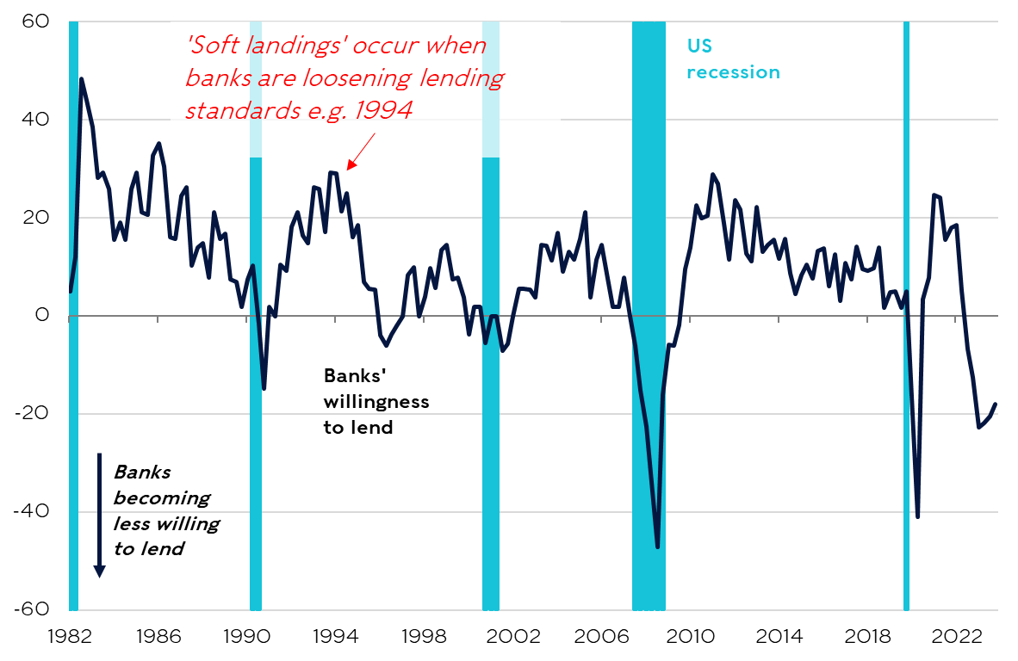
Banks are still tightening lending standards, but to a lesser extent than in recent quarters
US Senior Loan Officer Survey and recessions
Sources: LSEG, Rathbones
Notes:
A number of indicators that give us the longest lead on what lies ahead, such as the inflation-adjusted amount of money in the economy or commercial banks’ willingness to lend (see this chart) among others, have ticked up too and that’s encouraging. But because of the long look ahead they give us, this tells us that there’s a lower chance any contraction will continue in 2025 and tells us little about 2024’s prospects which are baked into the readings from these indicators from last year.
Of course, much like the effects of monetary policy, the lags between these warning signals and the start of a downturn are long and variable. US recessions have tended to arrive in the third year after the first Federal Reserve (Fed) rate hike. That covers 2024.
We retain a one-third probability of a US recession. The risk is much reduced, and this change in the balance of probabilities has been confirmed by rising equity markets.

Slide 18
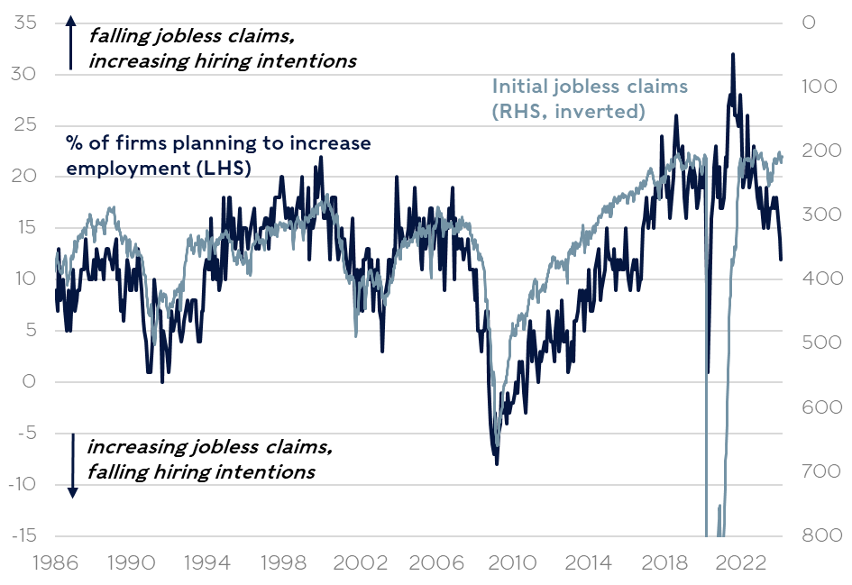
Economic risks haven’t vanished; IF hiring intentions keep falling, layoffs could rise
US initial jobless claims and firm hiring plans
Sources: LSEG, Rathbones
Notes:
As well as the long-leading indicators, labour market indicators are also signalling developments that historically would have been consistent with recession.
Survey-based measures of firms’ hiring plans have deteriorated and are consistent with an increase in unemployment (see chart). In the US, firms have already reduced the average worker’s hours and are shedding staff on temporary contracts; both have tended to signal a worsening outlook for full-time employment.
That said, these measures suggested a weaker outlook last year. It may be that with skilled workers in short-supply, most of the adjustment comes from firms hiring fewer people rather than laying off existing employees.
If a downturn does develop, we note that economies are less buttressed this year. Nearly all the factors that boosted growth in 2023 are unlikely to provide the same level of support in 2024 and in some cases will reverse a touch. American fiscal policy, for example, or sharply lower gas prices, or the stock of excess savings leftover from the pandemic which is now depleted in inflation-adjusted terms for the average household.

Slide 19
Some indicators of activity in China have picked up, but the deep property downturn will have long-lasting effects
Growth in China’s exports and imports (% y/y, USD)
China housing starts and sales (mns of square metres)
Sources: LSEG, Rathbones
Notes:
We remain sceptical about China’s ability to outperform sustainably over the next few years. Several factors continue to bear down on China’s trend growth rate, not least what will likely be a multi-year fallout from the bust of its overinflated property sector.
But the Chinese authorities appear have done enough to stabilise the economy, with economic data improving over the last couple of months. This certainly helps the global economic outlook this year and should help broader investor sentiment.

Slide 20
Key takeaways
Many leading indicators have improved recently, and the risk of recession appears to have diminished
But it has not disappeared either; the effects of previous tightening in monetary policy and banks’ lending standards may still be feeding through
Notes:
In short, more data is pointing up and we are more optimistic. Markets tend to respond more to the rate of change than they do to the level of these sorts of readings.
But we still think the risk of a developed market recession is about 1/3, and that makes us retain an element of defence in our investment strategy. The good news is that the traditional ballast in multi-asset portfolios, government bonds, look particularly attractive at present.

Slide 21
As 2023 reminded investors, switching to cash when interest rates peak usually doesn’t pay off
Performance of US equities vs cash portfolios (% median performance following peaks in interest rates since 1960)
Sources: LSEG, Rathbones
Investments can go down as well as up and you could get back less than you invested. Past performance is not a reliable indicator of future results.
Notes:
-So what does all of this mean for us as investors?
-If you were to take one lesson only from 2023, it has to be the importance of staying invested. We had lots of questions from clients and advisors in the middle of the year asking why shouldn’t they divest everything and stick it in cash at 5 or 6%. Well we back-tested this impact of cashing out at the various peaks in cash rates since 1960 – as you can see from this chart, it tended to mean losing out on a lot of return.
-If you are able to put money into risk assets, you should, because the future is always unknowable.

Slide 22
Historically, bonds begin to outperform in the months before rate cuts happen
Median performance of gilts around the start of easing cycles
Sources: LSEG, Rathbones; performance of 10-year and 2-year UK government bonds
Investments can go down as well as up and you could get back less than you invested. Past performance is not a reliable indicator of future results.
Notes:
- Longer duration bonds tend to do better once rate cutting cycles begin.
- There’s an asymmetry in the potential returns from gilts which makes them an attractive hedge. In the event of a so-called soft landing in the economy, UK interest rates may still fall by about as much as is discounted in markets (c.2 rate cuts), so yields might not move by very much and returns would be moderate.
- But in the event of a harder landing, interest rates would likely fall by much more than is widely anticipated, causing yields to fall sharply and returns from gilts to be strong.
- If inflation proved sticky (a lower probability scenario than the previous two in our opinion), we may get another two or three interest rate rises, and gilt returns could be negative but likely only mildly so. And, of course, held to maturity we know that we would still receive a positive return over the life of the bond.
- In short there’s an asymmetry in the potential returns from UK government bonds which makes them, in our opinion, a relatively low-cost hedge on equity-type risk and a useful source of return for lower-risk portfolios.

Slide 23
Firms which have strong balance sheets, higher interest coverage and more efficient investments have outperformed
Sector-neutral ‘quality factor’ outperformance (highest ‘quality’ vs lowest ‘quality’)
Sources: Piper Sandler, Rathbones
Investments can go down as well as up and you could get back less than you invested. Past performance is not a reliable indicator of future results.
Notes:
Given the improvement in the outlook for growth, we remain comfortable taking near neutral positions in equity-type risk.
We recognise that some other parts of the market may have gotten ahead of where the probability-weighted outlook suggests they should be. We discussed leading economic indicators earlier, and these tend to have a close correlation with market returns, but the recent returns to global equities have been consistent with periods historically when these indicators have reached their most ebullient readings, which they are someway short of today. Earnings forecast were also over-extended and 2024 profit expectations have been revised down lately, although this process appears to have stabilised in the last couple of weeks.
This doesn’t preclude the market from delivering decent returns, but it does tend to mean that higher quality and possibly more defensive businesses are more likely to outperform. They did particularly well in January, and selecting quality businesses with resilient returns on invested capital is a core focus of our investment process.

Slide 24
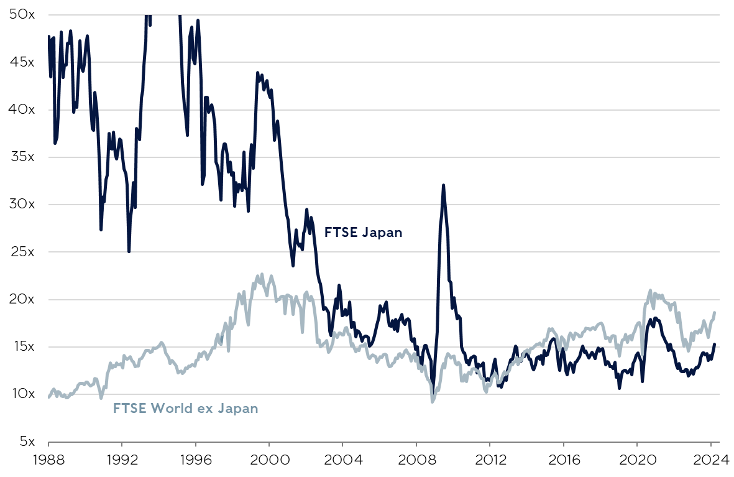
Japan’s NIKKEI INDEX HAS SURPASSED ITS 1989 PEAK; UNLIKE BACK THEN, VALUATIONS ARE MORE ATTRACTIVE RELATIVE TO ELSEWHERE
12M forward price/earnings ratios*
Sources: LSEG, Rathbones; *prices relative to forecasted earnings over the next 12 months
Investments can go down as well as up and you could get back less than you invested. Past performance is not a reliable indicator of future results.
Notes:
We also like investments desynchronised somewhat from the global business and interest rate cycles.
Japan has also been doing well for a few key reasons:
It doesn’t face the same inflation and interest rate pressures.
It’s benefitting from “not being China”! As investors and company are looking to redeploy capital from China to Japan.
Its equity market continues to be a beneficiary of improving governance on the back of Tokyo Stock Exchange initiatives.
Japan looks attractively priced, with more than half of companies having more cash than debt – no bad thing in a higher rate world, and the pace of Japanese companies buying back their shares with their surplus cash is accelerating (thus increasing the value of the shares still outstanding).

Slide 25


Companies aligned to major structural themes may do well
Investments can go down as well as up and you could get back less than you invested. Past performance is not a reliable indicator of future results.
Notes:
We are always on the lookout for companies and other investments that we can believe in over the long term, preferably aligned to the major themes of a changing world. To that end, we regularly produce thematic research reports in order to share our views on some of these structural shifts, and what they mean for your investments.
Our most recent thematic report – Building a More Sustainable Future - explores the key role of buildings in reducing future carbon emissions. One crucial point for investors to consider is that, without a dramatic contribution from these industries, net–zero targets won’t be met. The risks to the companies in the buildings and construction sectors will be significant in the decades ahead. But the opportunities for good investment returns will be as well, for those companies that can provide the solutions.
The recent explosion of interest in generative AI applications like ChatGPT has been the latest manifestation of cloud computing, the subject of another of our thematic reports. The Cloud Revolution highlights how dependent we are on cloud computing in our daily routines — at home, at work or at play — to an extent that would probably surprise most of us. And yet, how many investors remain unsure what is even meant by ‘the cloud’? What are the driving forces behind it? We believe cloud companies look set to enjoy a decadelong spending boom as enterprises seek to harness the benefits of this powerful new technology, and we look at some of the specific opportunities and risks for investors from this revolution in computing.
In the coming year, we’ll be exploring the implications of investing in a higher interest-rate world, which looks like it’s here to stay, and other major themes of our changing world.

Slide 26
Smaller stocks appear attractively valued, especially compared to US large caps
Difference in 12M forward price/earnings ratios* to S&P 500
Sources: LSEG, Rathbones;*prices relative to forecasted earnings over the next 12 months
Investments can go down as well as up and you could get back less than you invested. Past performance is not a reliable indicator of future results.
Notes:
- We are particularly enamoured by the long-term prospects of smaller and mid-market companies, and the valuations they trade at, which have widened to a near unprecedented gap with large caps.
- January 19th marked the first time since the Russell 2000 index of smaller American companies started in 1988 that the S&P 500, the large company index, made a new high while the Russell was still in a bear market, off 20% from its highs.
- Of course, small and midcaps are still vulnerable to a pullback if we do get a deeper economic downturn and relative valuations don’t tell us much of anything about short-term performance prospects.
- But it does give us more confidence in the magnitude of medium-to-long-term returns.

Slide 27
Key takeaways
The big lesson from 2023: markets have been volatile but if you were able to accept risk, it made sense to stay invested
Look for structural drivers, such as those found in Japan or from the major themes of a changing world
Look for areas that appear undervalued, such as smaller stocks in the US and Europe
With many market segments offering very attractively priced opportunities, there’s much to look forward to, even if there are a few bumps in the road ahead
Investments can go down as well as up and you could get back less than you invested. Past performance is not a reliable indicator of future results.

Slide 28
Additional INFORMATION
  Information valid as of 20.03.2024 unless otherwise stated.
  Tax regimes, bases and reliefs may change in the future.
  Rathbones Group Plc is independently owned, is the sole shareholder in each of its subsidiary businesses and is listed on the London Stock Exchange.
  Issued and approved by Rathbones Investment Management Limited, which is authorised by the Prudential Regulation Authority and regulated by the Financial Conduct Authority and the Prudential Regulation Authority. Registered office: Port of Liverpool Building, Pier Head, Liverpool L3 1NW, Registered in England No. 01448919.
  Rathbones is the trading name of Rathbones Investment Management Limited.
  Rathbones Asset Management Limited is authorised and regulated by the Financial Conduct Authority. Registered office: 8 Finsbury Circus, London EC2M 7AZ, Registered in England No. 02376568.
  Provision of trust, tax and company administration services are provided by Rathbones Trust Company Limited (RTC). Provision of legal services is provided by Rathbones Legal Services Limited (RLS), a wholly owned subsidiary of RTC. RLS is authorised and regulated by the Solicitors Regulation Authority. It should be noted that any services provided by RTC are not regulated by either the Financial Conduct Authority nor the Prudential Regulation Authority. Rathbones Trust Company Limited and Rathbones Legal Services Limited are registered in England under company numbers 01688454 and 10514352 respectively.
  Rathbone Financial Planning is part of Rathbones Investment Management Limited. It should be noted that not all the services provided by Rathbone Financial Planning are regulated by either the Financial Conduct Authority or the Prudential Regulation Authority.
Rathbones Investment Management International is the Registered Business Name of Rathbones Investment Management International Limited, which is regulated by the Jersey Financial Services Commission. Registered office: 26 Esplanade, St. Helier, Jersey JE1 2RB. Company Registration No. 50503.
Rathbones Investment Management International Limited is not authorised or regulated by the Prudential Regulation Authority or the Financial Conduct Authority in the UK. Rathbones Investment Management International Limited is not subject to the provisions of the UK Financial Services and Markets Act 2000 and the Financial Services Act 2012; and, investors entering into investment agreements with Rathbones Investment Management International Limited will not have the protections afforded by those Acts or the rules and regulations made under them, including the UK Financial Services Compensation Scheme.
This document is not intended as an offer or solicitation for the purchase or sale of any financial instrument by Rathbones Investment Management International Limited. The information and opinions expressed herein are considered valid at publication, but are subject to change without notice and their accuracy and completeness cannot be guaranteed. No part of this document may be reproduced in any manner without prior permission.
Greenbank and Greenbank Investments are trading names of Rathbones Investment Management Limited, which is authorised by the Prudential Regulation Authority and regulated by the Financial Conduct Authority and the Prudential Regulation Authority.
No part of this document may be reproduced in any manner without prior permission.
© 2024 Rathbones Group Plc. All rights reserved.

